Slide 1


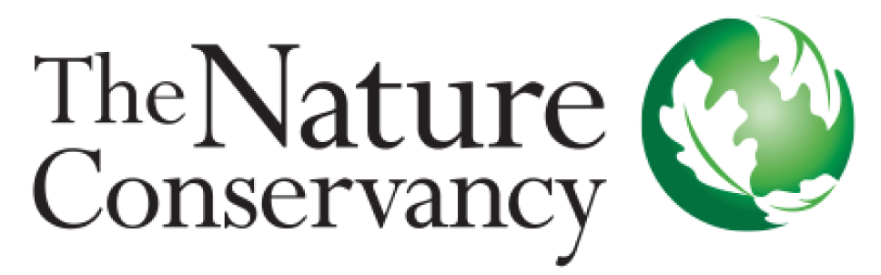
Value of monitoring facilitating efficient and adaptive biotoxin management in the West Coast Dungeness Crab fishery
Christopher Free, Stephanie Moore, Vera Trainer
ORHAB Steering Committee Meeting | November 9, 2021

Slide 2
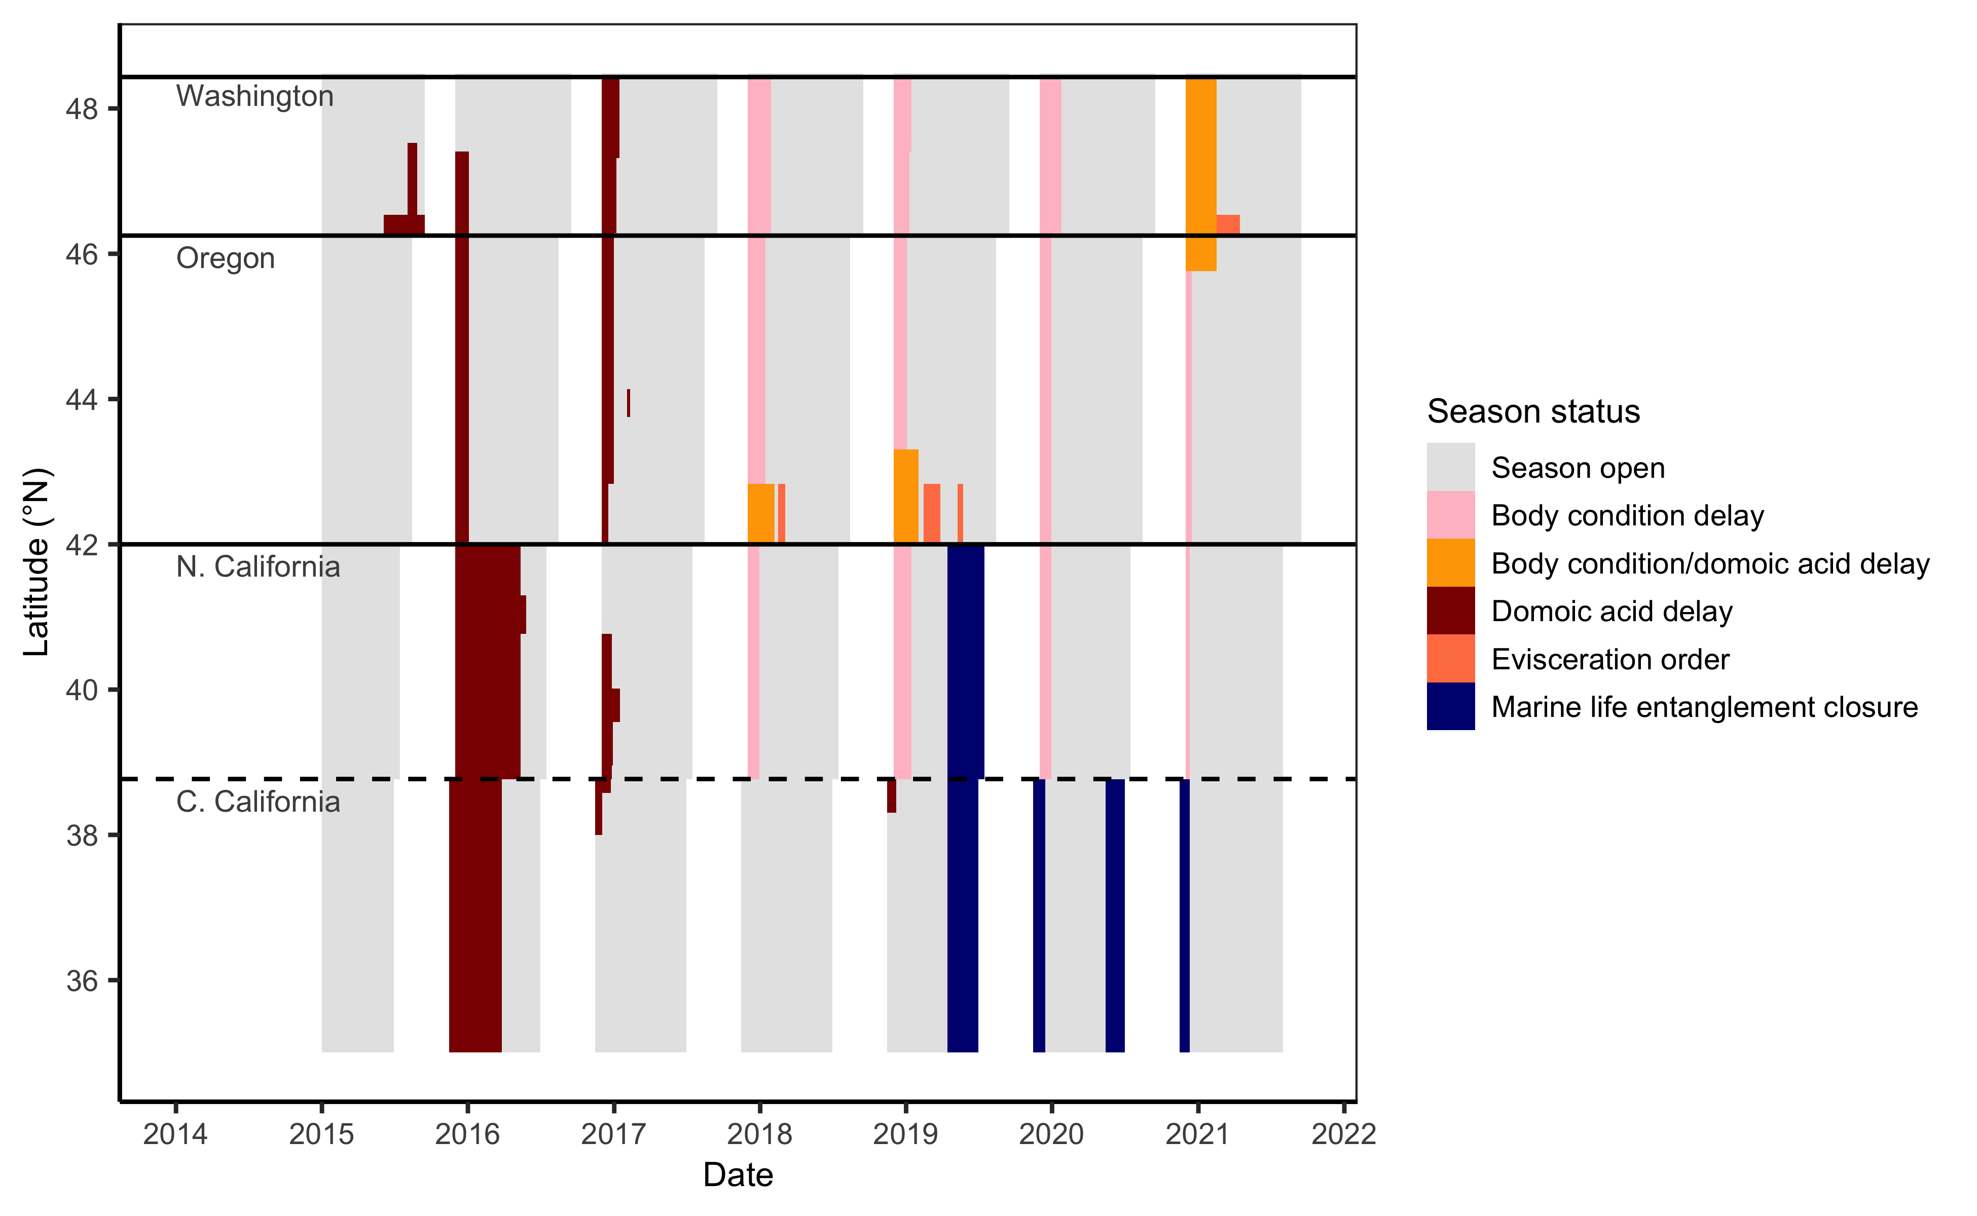
Impacts of HABs on the Dungeness crab fishery

Slide 3
Project objectives
Demonstrate the value of monitoring in facilitating biotoxin management that protects public health with minimal impacts on fishing opportunities.
Historical synthesis
Synthesize the history of monitoring and management
Identify design principles that facilitate efficient/adaptive management
Opportunity for states to learn from each other and a template for other regions confronting HAB and biotoxin challenges.
Simulation testing
Power analysis to assess the performance of 6-crab surveys
Simulation test programs with different spatial-temporal designs
Demonstrate the effectiveness of monitoring to stakeholders.
Elevate the role of simulation testing in designing monitoring programs.

Slide 4
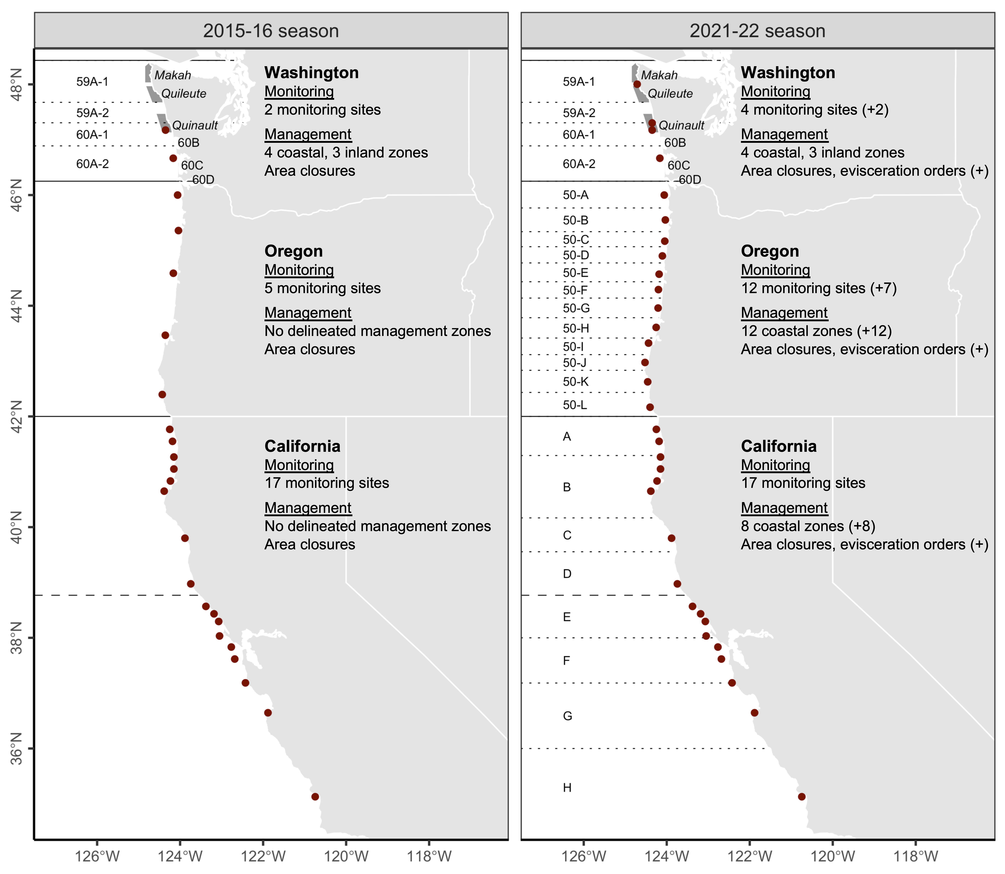
Management changes after the 2015 HAB event
Three major adaptations:
Expansion in monitoring
Delineation of clear mgmt zones
Legalization of evisceration orders

Slide 5
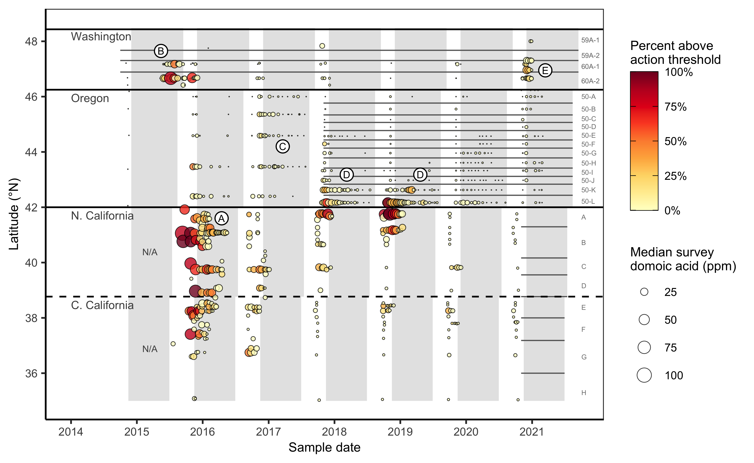
Monitoring history

Slide 6
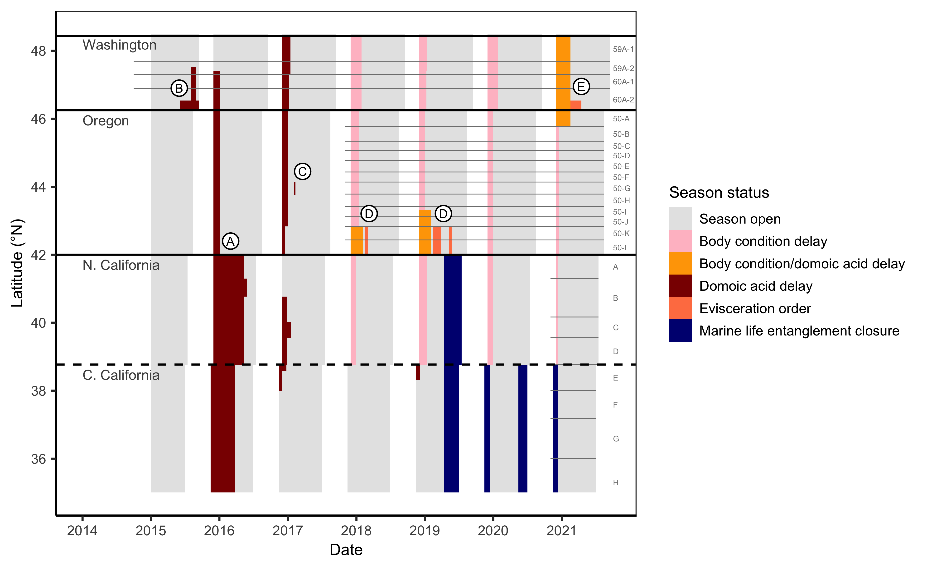
Management history

Slide 7
Is there mid- to late-season contamination risk?
Notes:
3 pieces of evidence

Slide 8
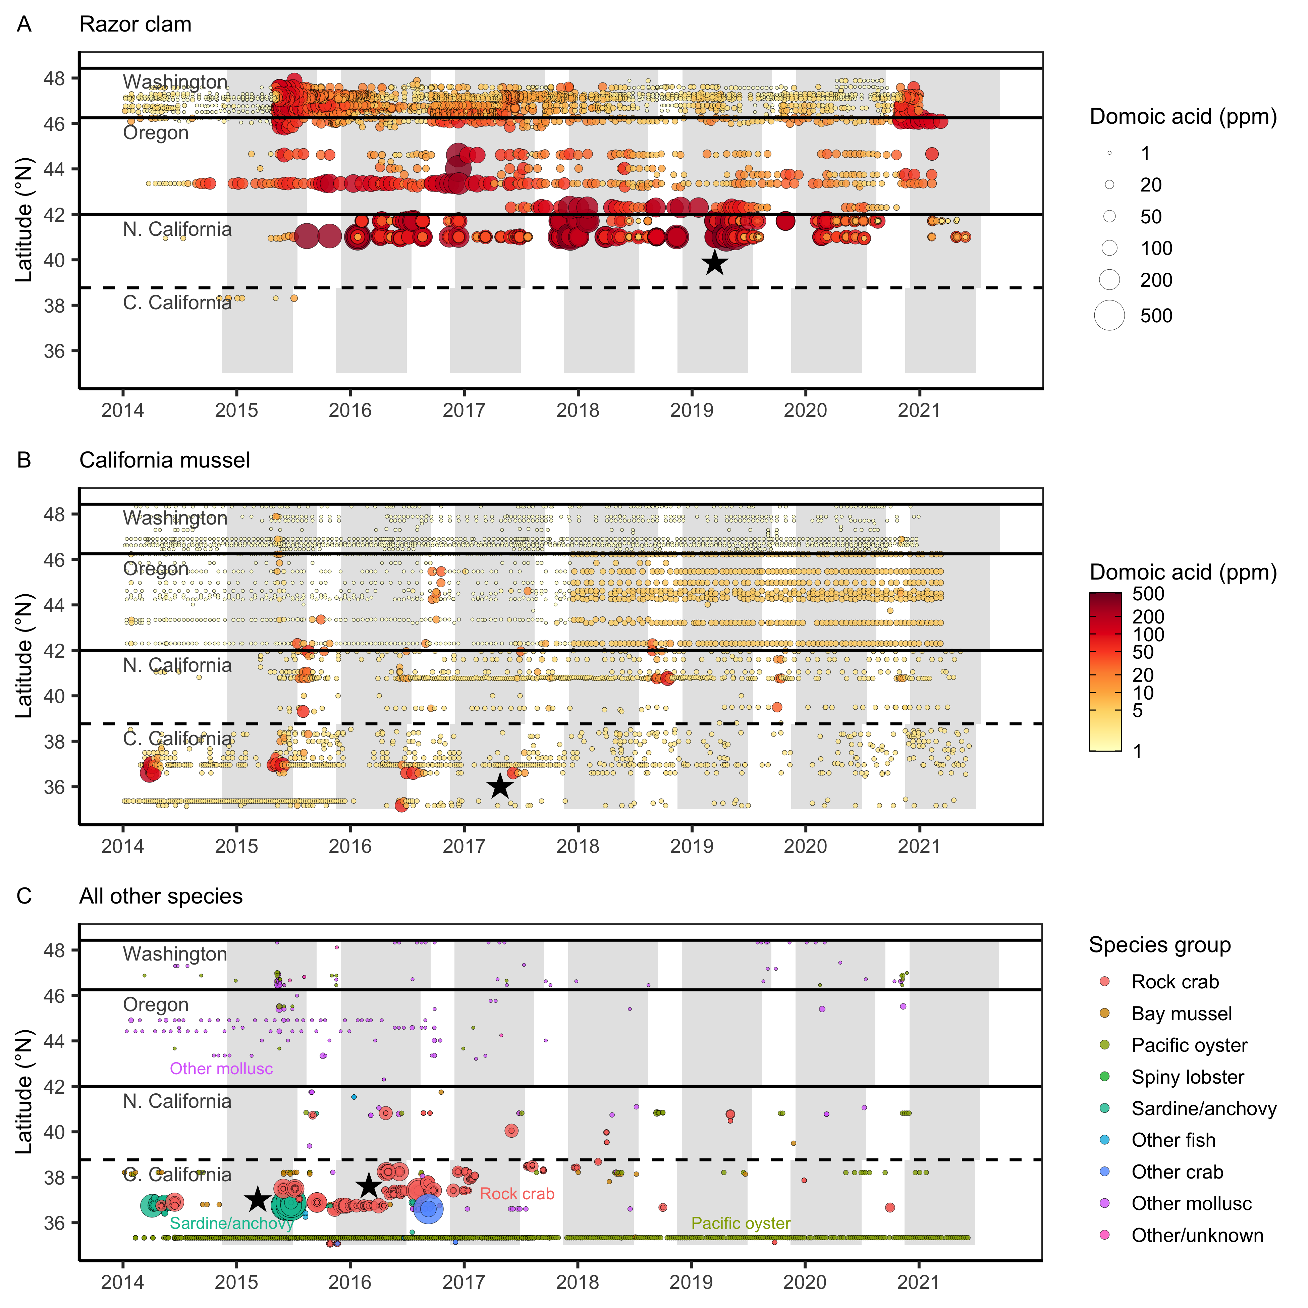
Evidence for mid- to late-season contamination risk

Slide 9
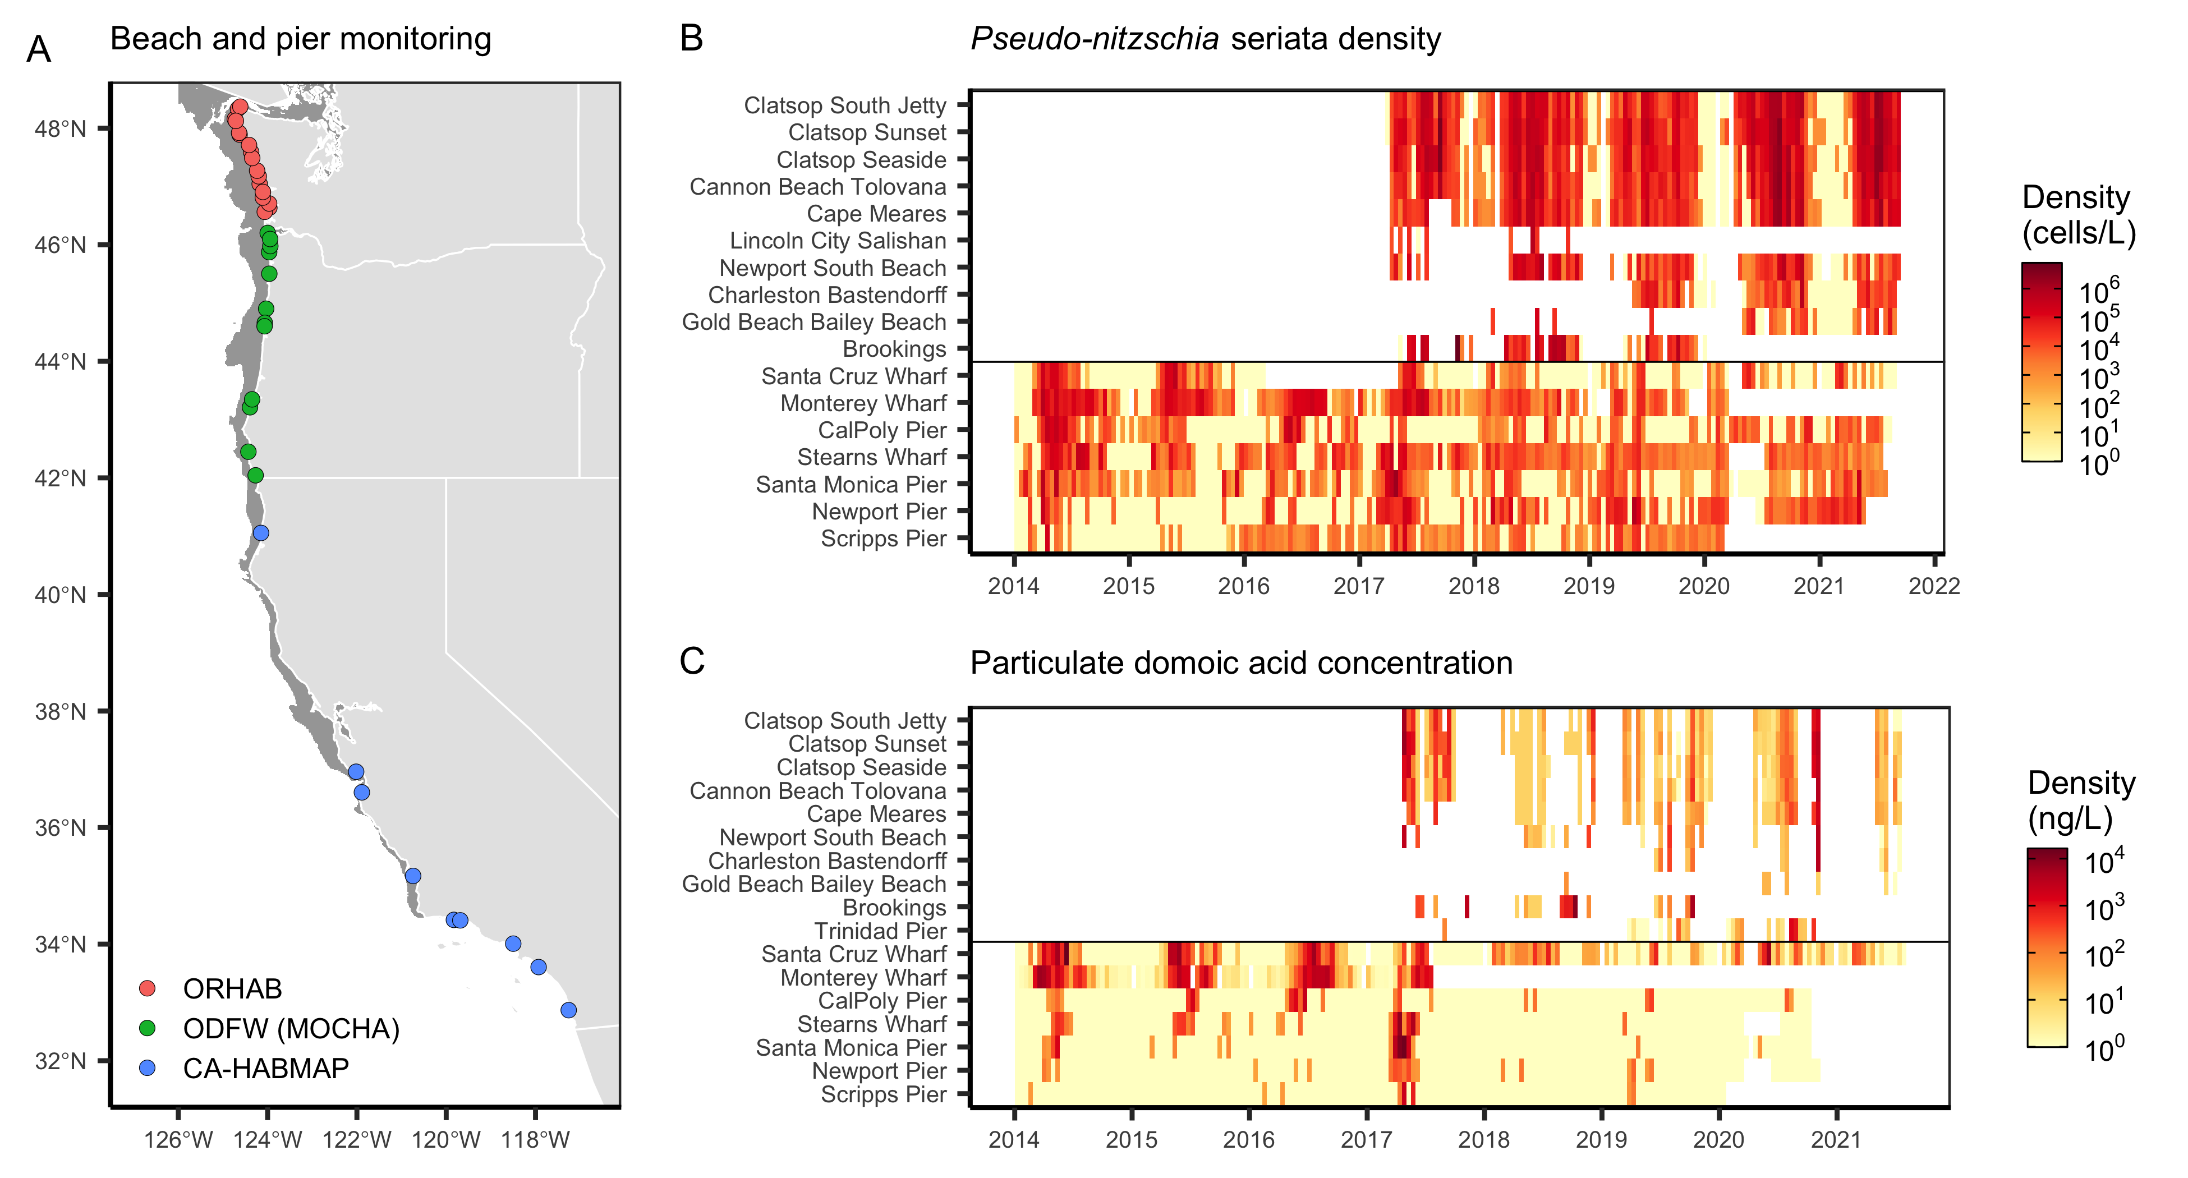
Evidence for mid- to late-season contamination risk

Slide 10
Use of ORHAB beach sampling data
Use in manuscript
Illustrate Pseudo-nitzschia densities and particulate domoic acid contamination in Washington relative to the Dungeness crab fishing season
Terms of use
Happy to share the paper and address feedback
Happy to acknowledge ORHAB using appropriate text
Won’t share data or post in a public repository
Won’t use for any other purpose without permission
Draft acknowledgement text
The Olympic Region Harmful Algal Bloom (ORHAB) partnership has been funded since 2006, a surcharge to Washington State shellfish and seaweed licenses as authorized by RCW 77.21.555. We express our gratitude to ORHAB for the collection and enumeration of samples containing Pseudo-nitzschia and domoic acid analysis. Should I acknowledge any specific partners as well?

